Slide 1
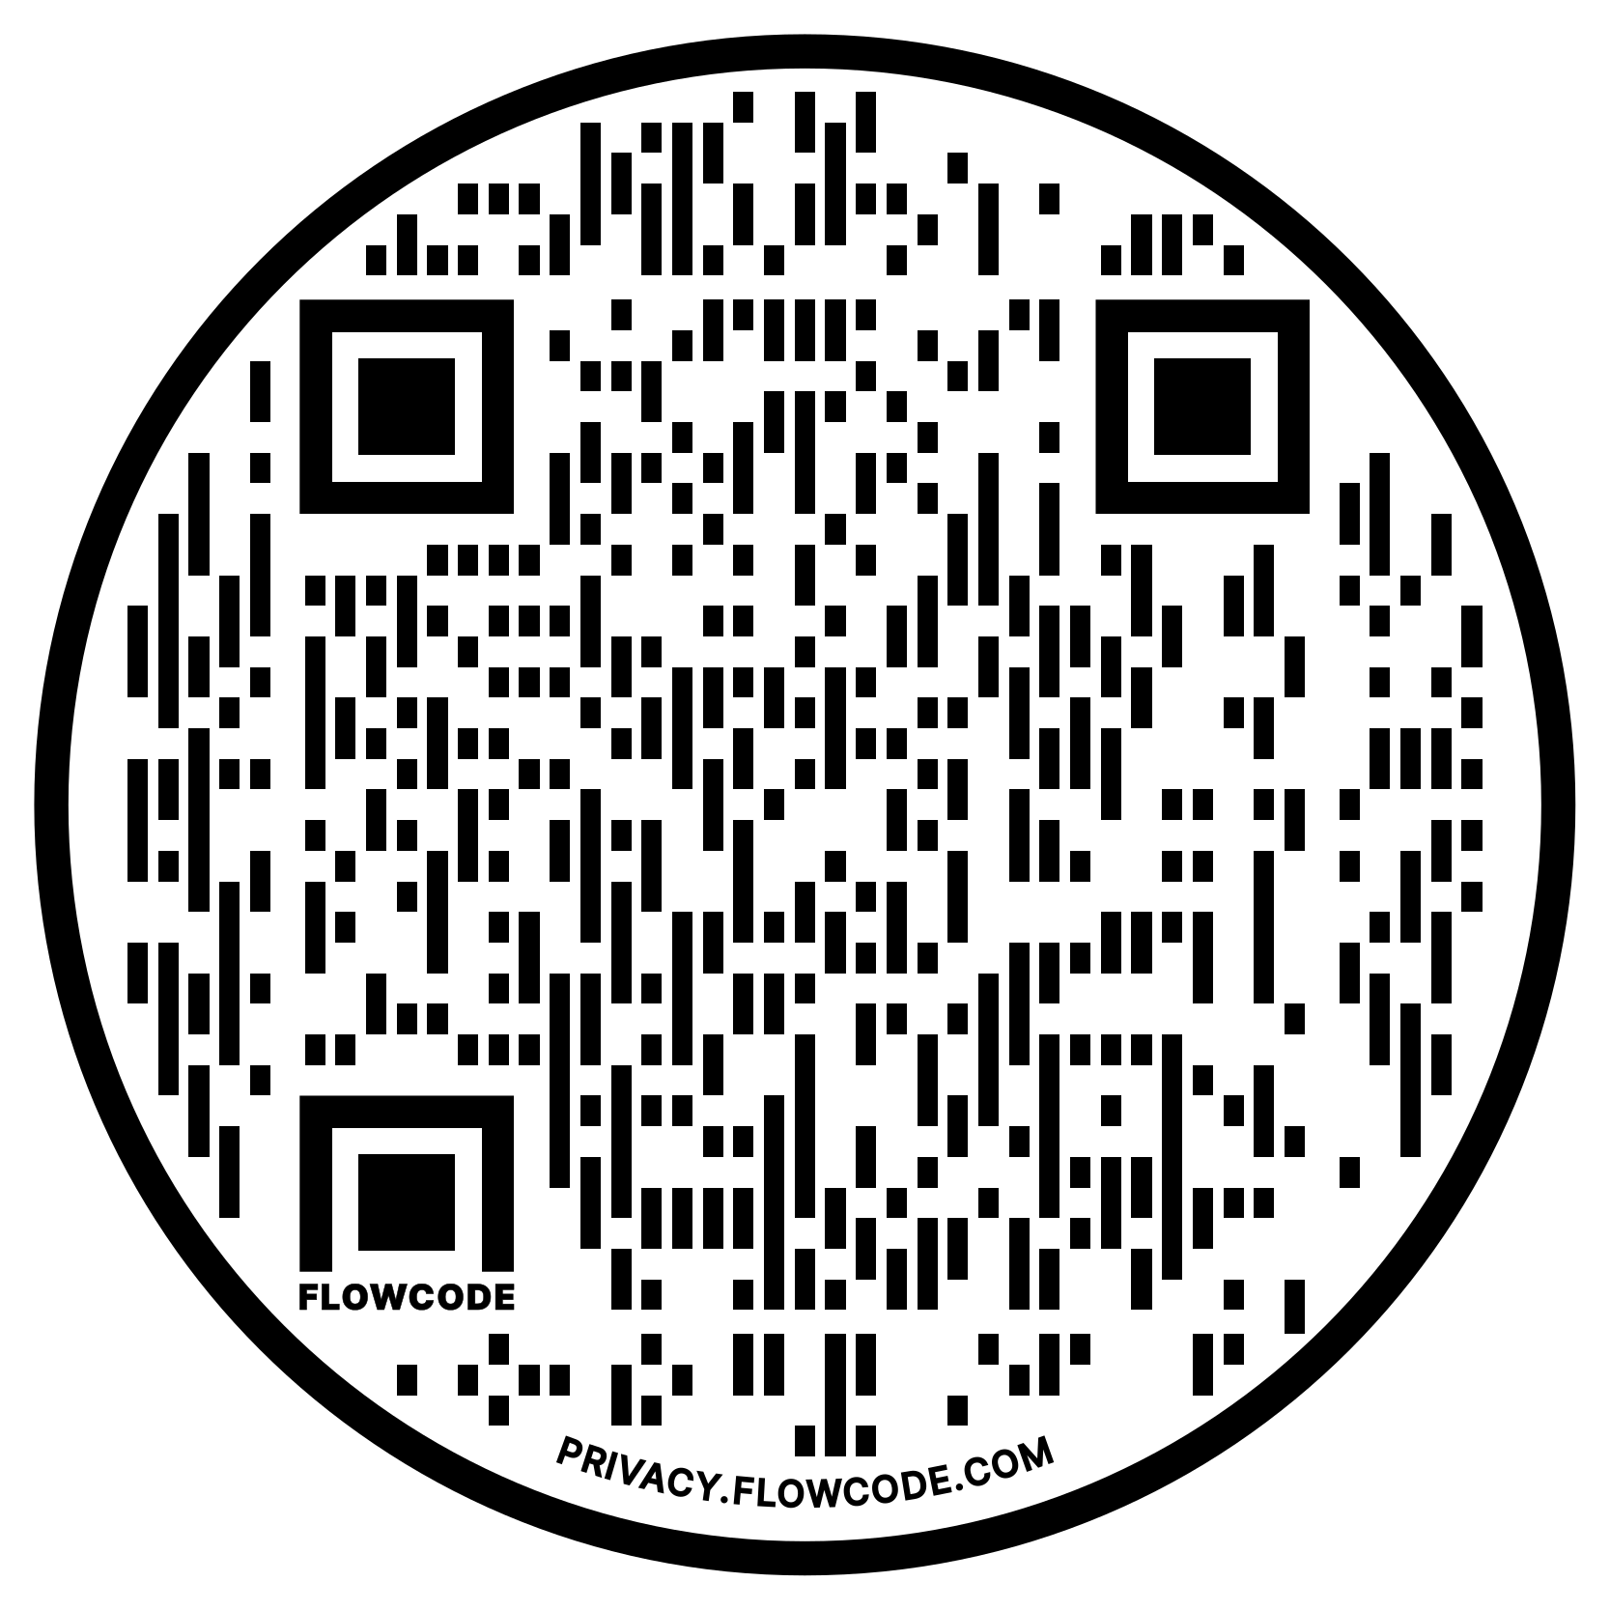



An Integrated Analysis of the Quantitative and Qualitative Methods Used in Mixed Methods K – 12 Educational Research and in Institute of Education Sciences Funded Research From 2014 – 2019
Karen M. Alexander and Jay Jeffries
Buros Center for Testing and University of Nebraska-Lincoln Department of Educational Psychology
Introduction
Educational research involving mixed methods (MM) provides valuable contextual information that may be missing from traditional quantitative research in education. While encouraged by IES, the Common Guidelines for Education Research and Development (Institute for Education Sciences; IES et al., 2013) does not contain any reference to the use of (IES et al., 2020). If either the quantitative (QUAN) or qualitative (QUAL) methods used within MM educational research lack rigor, then: That research is not only less likely to receive funding by the IES It raises concerns of the quality of MM research in the field of education.
Study Purpose
The study purpose is to explore potential differentials in the robustness of QUAN and QUAL research methods between published MM educational research and IES funded research. To analyze this, the following research questions were used: What QUAN methods have been used in MM K – 12 educational research and in IES funded studies from 2014 – 2019? What QUAL methods have been used in MM K – 12 educational research and in IES funded studies from 2014 – 2019? What relationships between the QUAN and QUAL research methods used in K – 12 educational research and IES funded studies are found by integrating the systematic review?
Legend
IES Study
Journal Article
Method
A convergent parallel mixed methods analysis was used to conduct a mixed methods systematic review (MM-SR) of the QUAN and QUAL methods used within MM educational research and IES funded research for K-12 education from 2014-2019 Inclusion Criteria: Between 2014 – 2019 Had to contain a measured student outcome Article had to use mixed methods while IES proposals did not Guidelines of The Preferred Reporting Items for Systematic Reviews and Meta-Analyses (PRISMA) (Moher et al., 2009) were implemented.
Coding:
Focused on methodology and study design, not specific outcomes using MaxQDA software (VERBI Software, 2019).
QUAN and QUAL methods were coded for complexity using an a priori framework (Onwuegbuzie, 2016).
Statistical analyses were conducted using R Markdown within the RStudio environment (Rstudio Team, 2021).
Discussion & Limitations
The underreporting of descriptive statistics is not too concerning as it is most likely understood that descriptive statistics will be included. The underreporting of QUAL methods is of greater concern as it speaks to the lack of emphasis on the value of QUAL methods.
Use this QR code to visit our GitHub site that holds more information about this project!
Results
Among the journal articles in the sample of studies, 91.41% (N = 234 articles) reported a process of QUAL coding or analysis whereas the research funded by IES only 13.22% (N = 39 documents) disclosed a type of QUAL analysis. This represents a significant difference, where χ²(1)= 335.17, p < .05. Non-IES funded research identified a QUAL data analysis method significantly more than IES funded studies. This is exemplified in journal articles that used deductive methods from complexity level 1 significantly more (χ²(1)= 56.69, p < .05), along with the medial analyses of level 2 (χ²(1)= 123.11, p < .05), and inductive-leaning methods in complexity level 3 (χ²(1)= 212.89, p < .05). All educational journal articles and IES funded studies reported at least one method of QUAN analysis. The studies funded by IES utilized multivariate analyses (χ²(1)= 6.47, p < .05), analyses of time and/or space (χ²(1)= 26.51, p < .05), multi-directional or multilevel models (χ²(1)= 231.81, p < .05), and multidirectional and multilevel modeling (χ²(1)= 27.53, p < .05) significantly more than non-IES funded journal articles. Journal articles implemented descriptive analyses (χ²(1)= 93.20, p < .05), univariate analyses (χ²(1)= 131.30, p < .05), and measurement techniques (χ²(1)= 4.93, p < .05) significantly more than IES funded studies. The proportion of documents that used complexity level 4 , analysis of group membership, was not significantly different among IES and non-IES funded research.
https://github.com/jjeffries13/MM-SR
The sample of IES funded studies derived from publicly available research proposals on the IES website. This was intentional as the desire was to focus on what type of research IES is funding
References
Institute of Education Sciences (IES), U.S. Department of Education (USDE), & National Science Foundation (NSF). (2013). Common Guidelines for Education Research and Development. https://ies.ed.gov/pdf/CommonGuidelines.pdf Institute of Education Sciences (IES), U.S. Department of Education (USDE), & National Science Foundation (NSF). (2020). Education Grant Research Program. https://ies.ed.gov/funding/pdf/2021_84305A.pdf Moher, D., Liberati, A., Tetzlaff, J., & Altman, D. G. (2009). Preferred reporting items for systematic reviews and meta-analyses: The PRISMA statement. PLoS Medicine, 6(7), e1000097. https://doi.org/10.1371/journal.pmed.1000097 Onwuegbuzie, A. J. (2016). A Call for Conducting Multivariate Mixed Analysis. Journal of Educational Issues, 2(2), 1-30. https://doi:10.5296/jei.v2i2.9316 Plano Clark, V. L., & Ivankova, N. V. (2016). Mixed Methods Research: A Guide to the Field. SAGE Publications, Inc. VERBI Software. (2019). MAXQDA 2020 [computer software]. Berlin, Germany: VERBI Software. Available from maxqda.com.
Future Study
Differences between journal articles and IES funded studies in terms of research methods, data collection methods, and mixed methods designs implemented. The influence that the five IES goals (exploration, development and innovation, efficacy and replication, measurement, and other goal) have on the reporting or choice of analyses methods.

